Slide 1
AI BASED SUPPLY CHAIN MAPPING
By Aarya Parua

Slide 2
The Problem
Modern armored vehicles used in India are built from parts sourced across a global, multi-tier supplier network
A crisis in one country can silently propagate through Tier-1 and Tier-2 suppliers
Even "safe" suppliers can be compromised through hidden ownership — a company can look domestic but be majority-owned by a state-linked entity in an adversarial country
Manually tracking this across multiple vehicle programs, dozens of suppliers, and ownership chains is slow and error-prone

Slide 3
System Execution
Ingests supplier, ownership, and Indian-alternate data
Lets the analyst pick a crisis scenario (a country/region in conflict)
Detects every supplier exposed to that crisis
Scores every supplier's risk using a deterministic formula, refined by an AI model
Recommends Indian alternate suppliers for the at-risk ones
Renders all of this as an interactive dashboard

Slide 4
Data Model
FILE | WHAT IT HOLDS
supply_chain.csv | Vehicle → Armored Vehicle → Component → Tier-1 Supplier (+country) → Tier-2 Supplier (+country)
ownership.csv | Supplier → Owner → Owner Type → Owner Country → Stake % → Board Role→ Financial Distress Score
indian_alternates.csv | Indian Company → Component Category → Components Supplied → Country → Lead Time in Weeks

Slide 5
Three-Path Crisis Exposure Detection
A supplier is flagged as exposed to the selected crisis country if any of these are true:
Direct — the supplier itself is located in the crisis country
Tier-2 Dependency — the supplier's upstream (Tier-2) supplier is located in the crisis country, so risk propagates up the chain even if the Tier-1 supplier itself looks safe
Ownership-Linked — the supplier is owned, even partially, by an entity headquartered in the crisis country — regardless of where the supplier physically operates

Slide 6
Supplier Risk Scoring
Risk Score = Base Weight
+ Geopolitical Signal Score (0–20)
+ Ownership Risk Score (0–15)
+ Financial Distress Score (0–10)
+ Concentration Penalty (0–5)
→ ( capped at 100 )

Slide 7
TERM | WHAT IT REPRESENTS
Base Weight | Category/component criticality
Geopolitical Signal | Is the supplier's country, or its upstream/ownership chain, tied to the active crisis?
Ownership Risk | Ownership stake from ownership.csv
Financial Distress | Placeholder hook (financial_distress column in ownership.csv) for future financial-health signals. 0 = Financially healthy — no distress signals. 5 = Moderate distress — some financial strain but not existential. 10 = Severe distress — active red flags: heavy losses.
Concentration Penalty | Is this supplier the only source for that vehicle/component — a single point of failure?

Slide 8
Alternate Supplier Readiness Scoring
Readiness Score = Capability Match (0–30)
+ Country Risk Bonus (0–25)
+ Capacity Signal (0–20)
+ Lead-Time Score (0–15)
+ Existing Relationship (0–10)
→ ( capped at 100 )

Slide 9
COMPONENT | WHAT IT REPRESENTS
Capability Match | Exact match between component category under Indian alternates csv and the at-risk supplier’s component/category → 30. Partial keyword match > 15. Category-only match > 5.
Country Risk Bonus | Alternate’s country = India → 25. Allied/neutral country → 10–15. Same country as the crisis-hit supplier → 0.
Capacity Signal | Alternate supplier's production volume and manufacturing capability.
Lead-Time Score | Operational delay and efficiency involved in onboarding and receiving parts from an alternate supplier compared to the original one.
Existing Relationship | If the alternate already supplies a different component in the same vehicle program → 10 (faster onboarding, known vendor). Else 0.

Slide 10
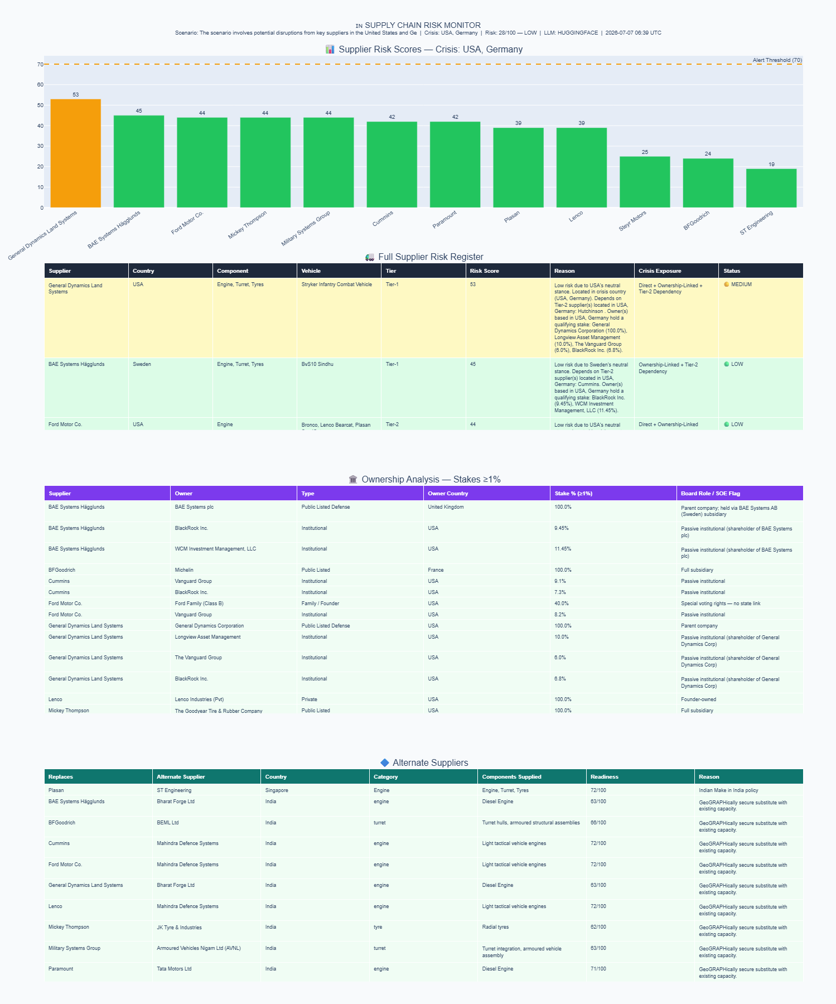
The Graph Plots & Dashboard

Slide 11
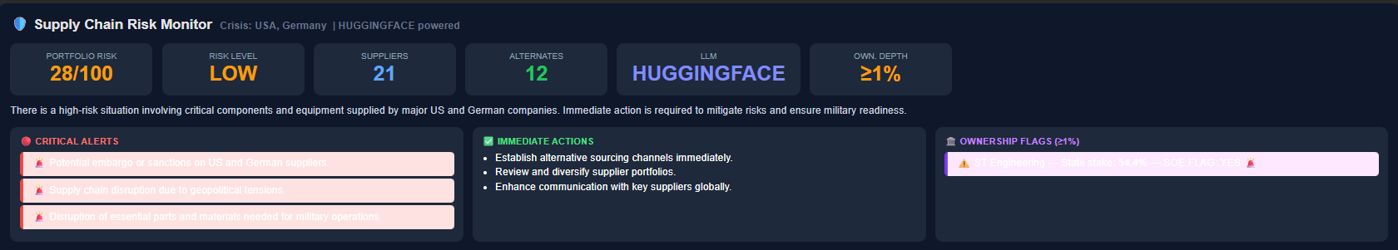
The three-path exposure detection filters suppliers
render_dashboard() builds a Plotly subplot figure (KPI band, risk bar chart, supplier table, ownership table, alternates table) plus an HTML KPI banner.
Output as both a live widget and a static embedded HTML fallback, and dumped to dashboard_output.json.

